Slide 1

Idea Creation ON LUXARY FASHION AND ACCESSORIES STORE Batch Number : CSE AIML OMEGA- 1 By
Year / Semester: I st yr / II nd sem
Branch /Section : CSE – AIML / OMEGA
R.KEERTHI ~ 2411CS020529
P.VIRIJA ~ 2411CS020479
P.ASRITH ~ 2411CS020480
P.SATHWIK ~ 2411CS020468
P.VINAY ~ 2411CS020494
Under the Esteemed Guidance of
Mr. DR . J . Pradeep Kumar
( ASSISTANT ASSOCIATE PROFESSOR, CSE - AIML )

Slide 2
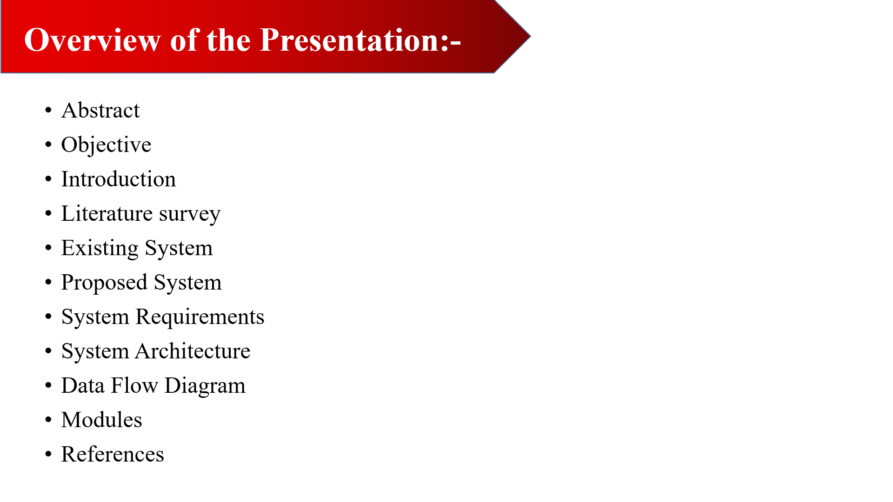


Slide 3
ABSTRACT:
Here is the information about luxury wear and premium clothing and accessories
We provide a quality and trust worthy goods up to your door .
As the main theme of our website is to achieve a prominent customer care.
We will provide a qualitative type of dresses and accessories at your satisfying
cost.
We maintain a fashion trend at all the seasons.
Cloths and accessories in our website are up to mark.
Our website is mainly user friendly and can easily accessible

Slide 4
ABSTRACT:
We maintain integrity of customer and their details in a secured manner
We provide most products at reliable prices.
We provide responsive designs to the customer
We provide exact and quality visuals , looks of the products
We give all the details of the product to educate user.
We showcase all the reviews and comments from customer to build trust.
We ensure to provide quick responsive customer care.

Slide 5
OBJECTIVE:
SHOWCASE PRODUCTS: We display luxury cloths and accessories with quality images and detailed descriptions.
BUILD BRAND IDENTITY: We reflect our brand identity by our elegance and having a unique logo.
INCREASE SALES: We do promotions via social media , posters and advertisements. To increase sales we also open branches of our store as possible.
GATHER CUSTOMER DATA: We constantly have a look on insights and reach of our products in market and make changes according to that through customer data.
OFFER EXCLUSIVE CONTENT: Provide special content like suggestions and offers to make customer enhance to buy product.
CUSTOMER SUPPORT: We always give excellent customer support through live chat , FAQs, and easy-to-find contact information.

Slide 6
INTRODUCTION:
Luxurious and Sophisticated Fashion: The website offers premium clothing and accessories for men, women, and children 5+ years with a focus on high-quality textures, craftsmanship.
Global Reach: Collections are available across India and select international locations, with fashion trends adapted from around the world.
Customer-Centric Approach: Prioritizing customer opinions and choices, the website ensures a seamless, immersive shopping experience with 24/7 customer care assistance.
Exclusive Memberships: Customers can join a community through memberships and passes, enhancing their shopping journey and fostering a loyal society of fashion enthusiasts.
Commitment to Elegance and Style: Every item in the collection is designed to make customers look elegant, with the ultimate goal of creating fashionable individuals.
~ Your desires are our investmets & Our service is your trust!!

Slide 7
LITERATURE SURVEY-I:
Title : “Luxury fashion and branding “
Author : “ T.san-Ming-choi”
Several studies have analyzed the trends and consumer behavior in luxury retailing
Digital Transformation in Luxury Retail: Research highlights how digital platforms have reshaped luxury shopping, enabling brands to offer personalized services through AI technologies.
2. Consumer Behavior in Luxury Markets: Studies indicate that luxury consumers prioritize brand heritage, exclusivity, and superior customer experiences.

Slide 8
1. E-commerce and Luxury Brands: Reports show that luxury brands must balance online accessibility with maintaining brand prestige.
2. Sustainability in Luxury Fashion: Recent trends suggest a growing demand for ethically sourced and sustainable luxury products.
These survey analyse the midset of the customer to make the requirements beneficial.
LITERATURE SURVEY-II:
Title : “Fashion and emerging brands ”
Author : “Cesare sestina”

Slide 9
.
EXISTING SYSTEM:
HIGH-END VISUAL PRESENTATION: Luxury websites often feature high-quality images, videos, and 360-degree views of products to showcase the intricate details and craftsmanship of their items.
PERSONALIZED SHOPPING EXPERIENCE: Many luxury fashion websites creates a tailored shopping experience that enhances customer satisfaction and loyalty.
HIGH COSTS: Implementing and maintaining advanced technologies and high-quality content can be expensive. This can result in higher operational costs that may be passed on to consumers in the form of higher prices.
LIMITED ACCESSIBILITY: Luxury websites often target a specific affluent demographic, which can result in a less inclusive shopping experience. This exclusivity can alienate potential customers who are interested in the brand but cannot afford the high price tags.

Slide 10
VOICE COMMERCE INTEGRATION: Integrating voice-activated shopping features that allow customers to browse and purchase products using voice commands.
VIRTUAL TRUNK SHOWS: Hosting virtual trunk shows where customers can view and pre-order exclusive collections before they are available to the public.
SOCIAL COMMERCE INTEGRATION: Integrating social media platforms with the website to allow for seamless shopping experiences. Customers can discover, share, and purchase products directly from social media posts and stories.
VUMERABLE PARAMETERS OF CLOTHS : Customers can choose the size of the cloths by their body shape to fit the dress perfectly.
PROPOSED SYSTEM:

Slide 11

SYSTEM REQUIREMENTS:
HARDWRE REQUIREMENTS :
- High-performance servers for e-commerce platform hosting.
- Secure POS systems for in-store transactions.
- Surveillance and security systems for store protection.
SOFTWARE REQUIREMENTS:
- Customer Relationship Management system for personalized shopping experiences.
Payment gateway integration for secure transactions.
NETWORK REQUIREMENTS:
- High-speed internet connectivity for online store operations.
- Secure Wi-Fi network for in-store digital interactions.
Cloud storage for data security and scalability.
SECURITY REQUIREMENTS:
- SSL encryption for secure online transactions.

Slide 12
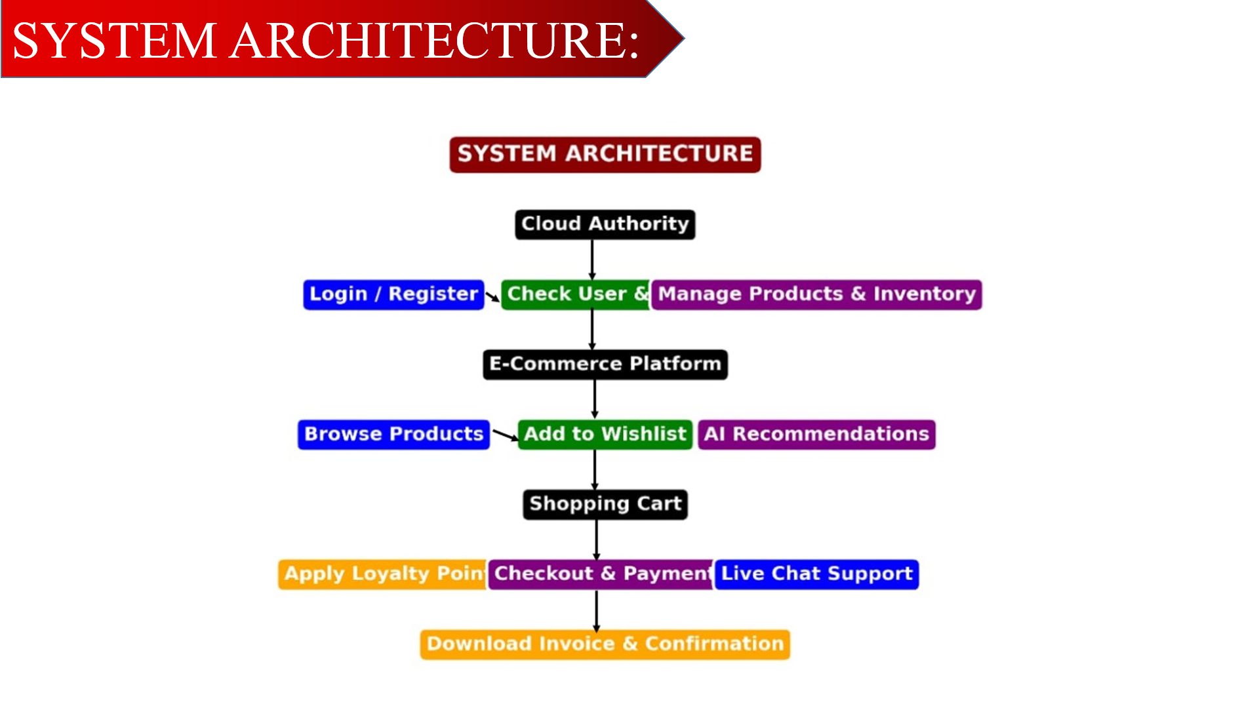

Slide 13
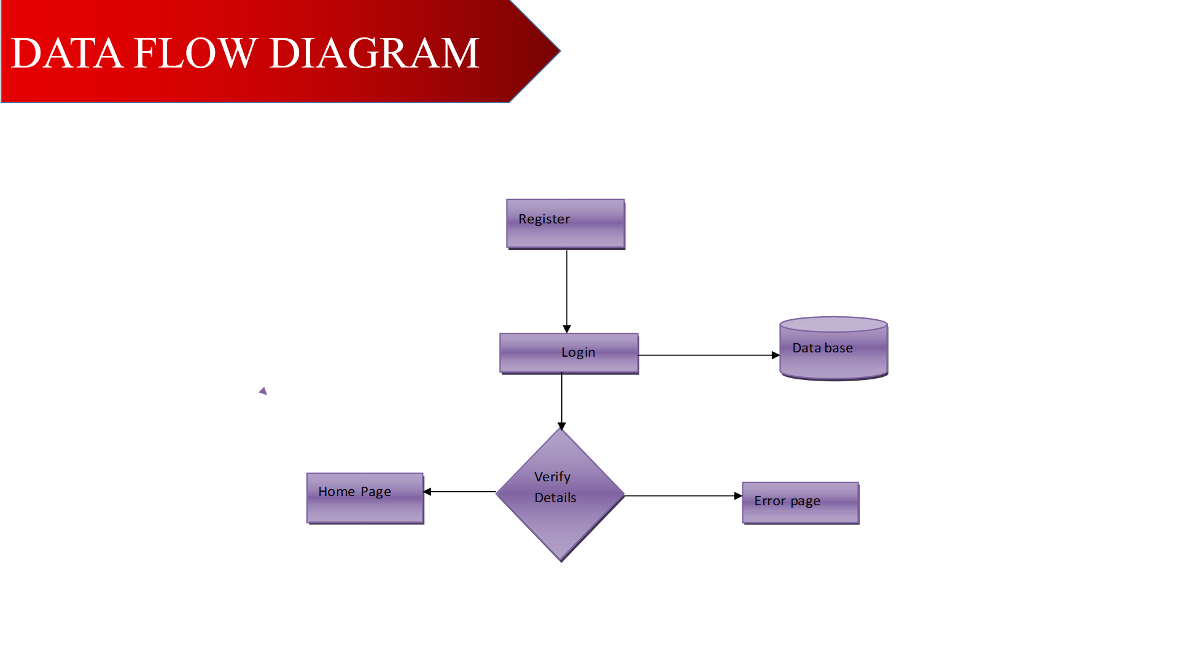

Slide 14
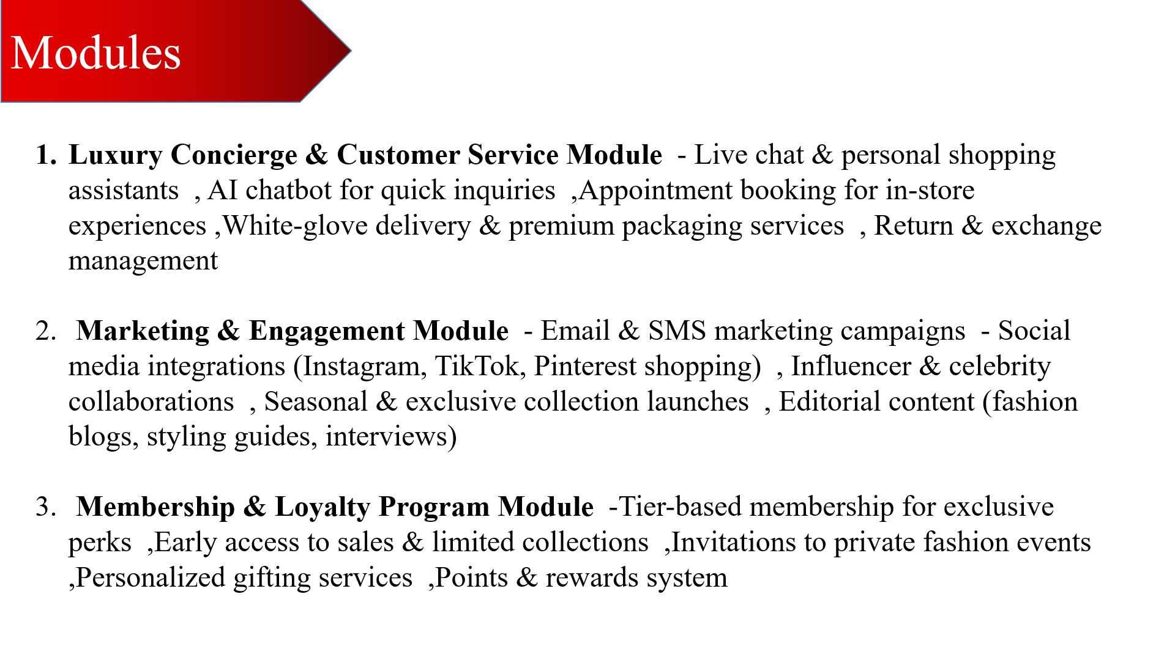

Slide 15
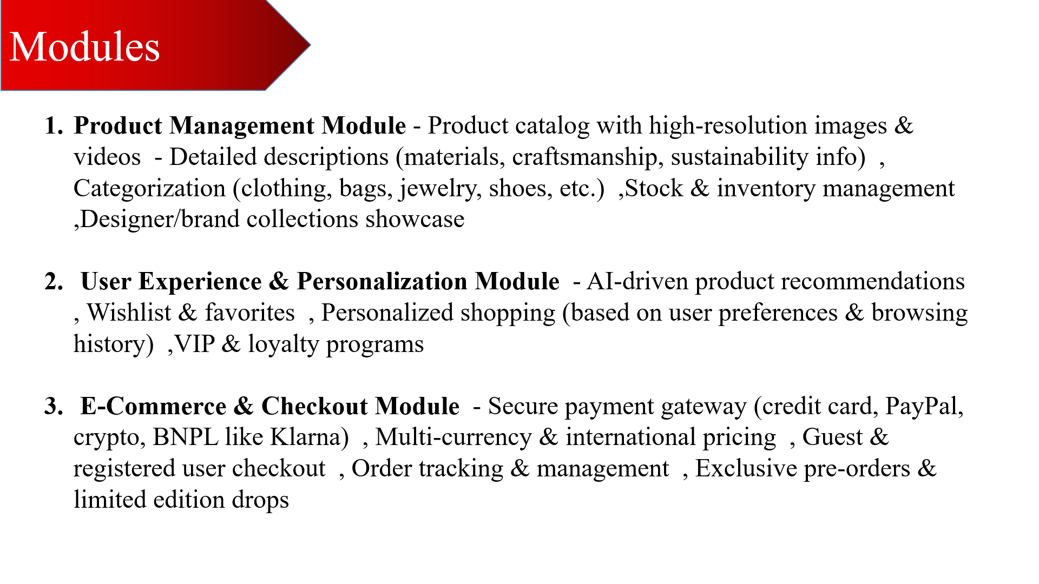

Slide 16
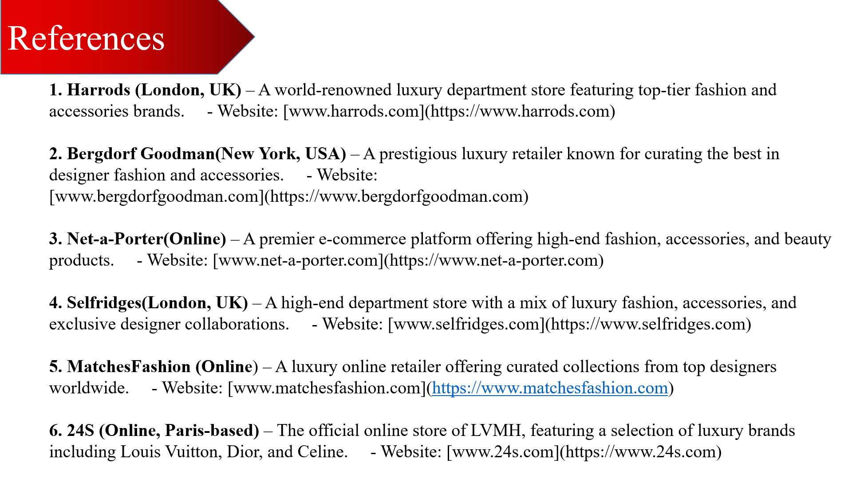

Slide 17


